Slide 1


40th Policy Advisory Committee
11 July 2024

Slide 2

Agenda
Introduction & Membership Matters
Matters Arising
  Policy Proposal: Amendments to PAC Terms of Reference
Criminal & Technical Abuse
  NetCraft Service Update
  Discussion - Internet Watch Foundation Processes
NIS2 Updates
Internet Governance
  WSIS+20, GDC, & Technical Community Updates
  Debrief from EuroDIG 2024
  Ireland IGF announcement
AOB

Slide 3
Membership Matters
Please keep microphones muted throughout the call
Please "raise a hand" to ask a question or add comments in the chat box
Before speaking, please state your name for the record
Meeting will be recorded to assist with minute drafting
Recording will be deleted once the Minutes are approved by the PAC

Slide 4
Minutes of PAC #39
Meeting minutes are circulated to the membership after each meeting.
Comments & feedback are accepted over a two-week period.
If edits are requested, and consensus exists, these are reflected in the Minutes.
Minutes and slides are published on weare.ie after the comment period has ended.

Slide 5

Matters Arising
Proposal: Amendments to PAC Terms of Reference & Policy Development Process

Slide 6
Proposals – Amending PAC Terms of Reference
At PAC 39, a proposal was introduced to update and amend the Eligible Organisations appendix in the PAC Terms of Reference.
The Eligible Organisations List had several out-of-date references and did not include any of the Digital Regulators.
Another suggestion was made to streamline similar policy amendments in the future.

Slide 7
Amendment 1: PAC Eligible Organisations
Current List (Apr 2021) | Proposed List (July 2024)
*Amend Name* Department of Communications, Climate Action & Environment (DCCAE) *Amend Name* Department of Business, Enterprise & Innovation (DBEI) *Remove*Internet Service Providers Association of Ireland (ISPAI) Accredited .ie Registrars Irish Computer Society (ICS) Law Society of Ireland Small Firms Association (SFA) Association of Patents and Trademarks Attorneys(APTMA) HEAnet Enterprise Ireland *Amend Name* Cybersafe Ireland Irish Reporting & Information Security Service (IRISS) | Observer Members Department of Environment, Climate & Communications (DECC) Department of Enterprise, Trade and Employment (DETE) Enterprise Ireland *New* ComReg *New* Data Protection Commission *New* Coimisiún na Meán *New* Competition & Consumer Protection Commission Non-Observer Members .ie Accredited Registrars Association of Patent & Trade Mark Attorneys (APTMA) CyberSafeKids HEAnet Irish Computer Society (ICS) Irish Reporting & Information Security Service (IRISS) Law Society of Ireland Small Firms Association (SFA)

Slide 8
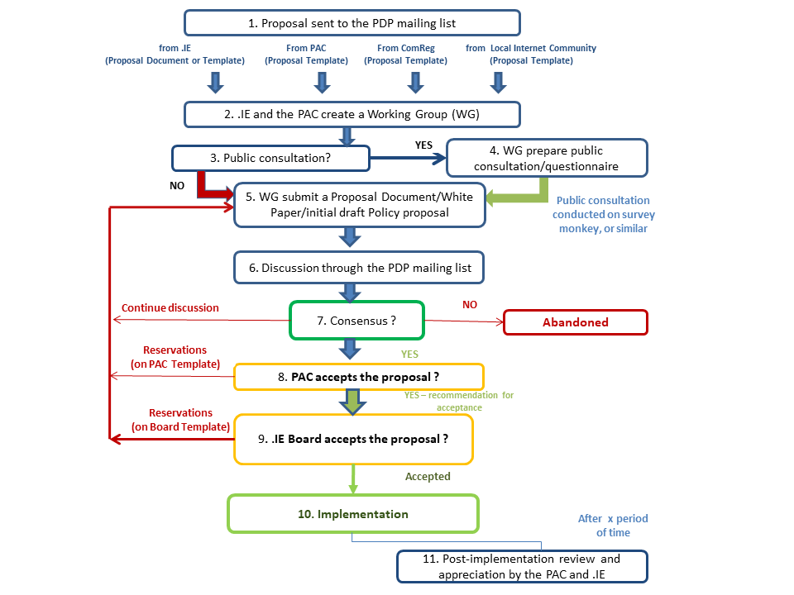
Amendment 2 – Policy Development Process
Current PDP Model
Issues
Not reflective of practice
Every proposal in chart requires working group
No process for minor (de minimis) issues like correcting typos or updating links (all changes currently to go to PAC)

Slide 9
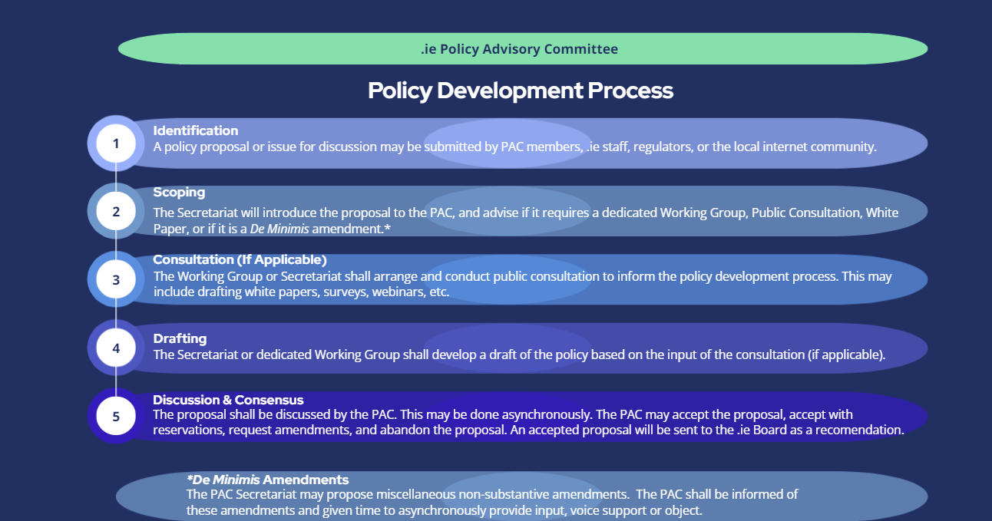
Amendment 2 – Policy Development Process
Proposal: PAC to asynchronously provide input, support, or objection by PAC 41.

Slide 10
Criminal & Technical Abuse
Updates from NetCraft Service
Participation in IWF

Slide 11
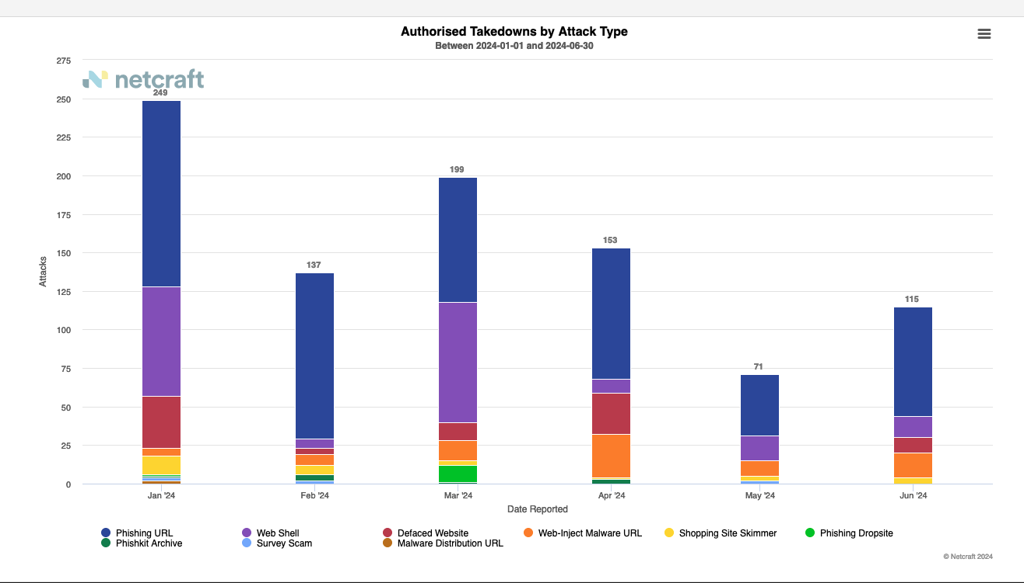
NetCraft
Number of Attacks (YTD)

Slide 12
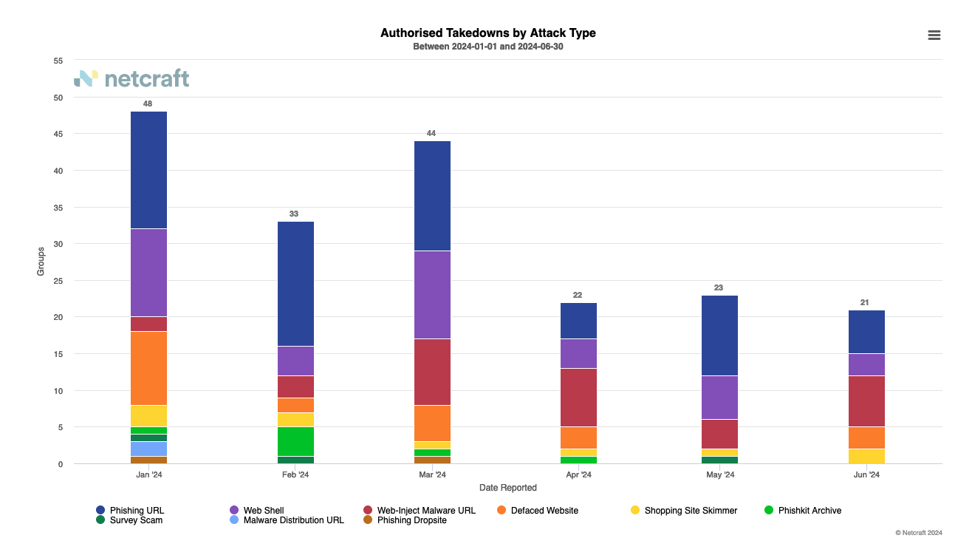
NetCraft
Attacks by Group (YTD)

Slide 13
Discussion – Internet Watch Foundation
At PAC 39, the IWF presented on their Domain Alert and TLD Hopping List Services.
  Domain Alert provides real-time alerts of confirmed CSAM on a TLD’s domain.
  TLD Hopping List provides list of domain strings known to be used to distribute CSAM.
The PAC was generally supportive of .ie participating in these programs but emphasized that .ie should have processes in place to handle IWF reports.
Discussion: What could a IWF mitigation process for .ie look like?

Slide 14
Discussion – Internet Watch Foundation
Public Interest Registry (.org & .ngo)’s process for Domain Alerts.
Domain Alert received from IWF to PIR with “defanged” URL.
PIR notifies RAR & Authorities.
PIR confirms if RAR has mitigated issue.
If no confirmation from RAR in 48 hours, PIR follows up again.
If no confirmation in 96 hours (4 days), domain is suspended.
Notify parties & monitor for appeals.
NOTE
A “defanged” URL is one that has been modified so it does not resolve (hxxps://example.ie)
Potential to replicate or adapt similar process for .ie.

Slide 15
Discussion – Internet Watch Foundation
Possible process for TLD Hopping List.
Domain is included on TLD Hopping List
.ie places Domain on reserved domain list.
RANT may apply for domain
If application accepted, registration can occur.
If rejected, .ie decision can be appealed to the Board of Directors.
NOTE
A reserved domain is restricted from being registered normally. This is different from a blocked domain, which can never be registered.
Due to the higher risk with these domains, the list of domains should not be published.
A process for RANTs to apply for reserved domains was approved by the PAC at PAC 24 (11 June 2020).

Slide 16
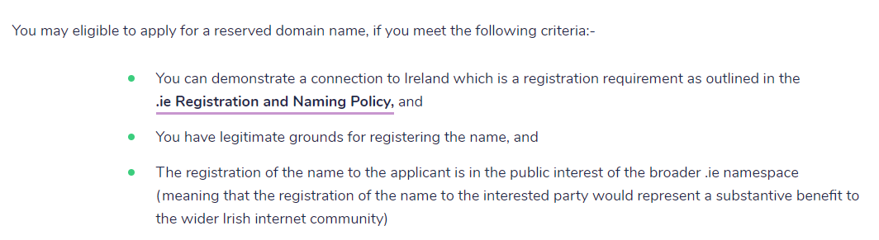
Discussion – Internet Watch Foundation

Slide 17
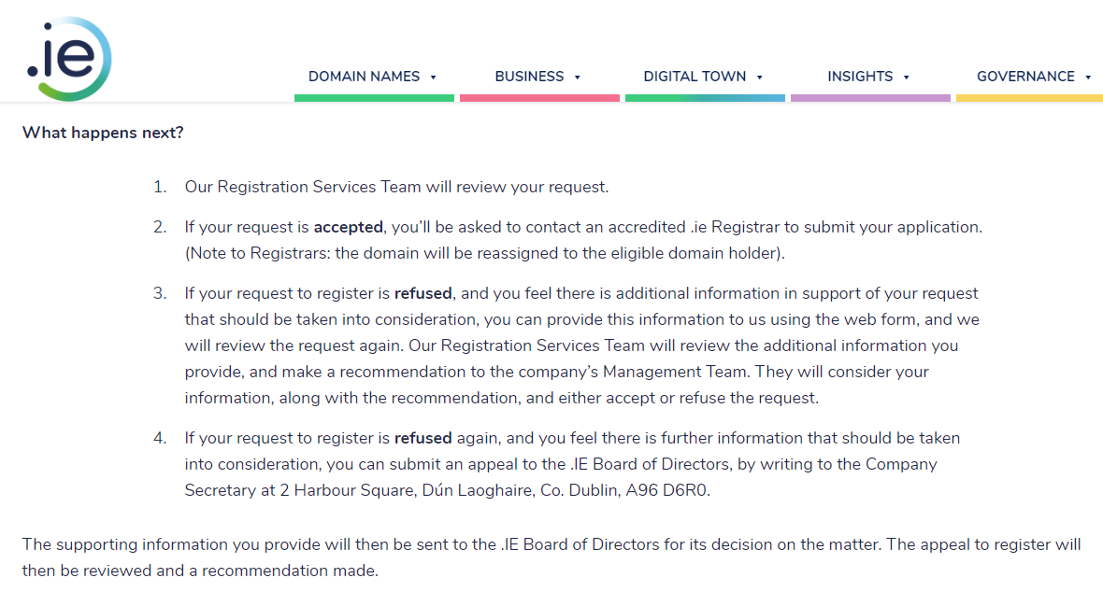
Discussion – Internet Watch Foundation

Slide 18

Roadmap & Tracker
Key Updates
Updates from Working Group
Tour de Table
NIS2

Slide 19
NIS2 Roadmap
Task Complexity
High:
Med:
Low:
 | Q2 2023 | Q3 2023 | Q4 2023 | Q1 2024 | Q2 2024 | Q3 2024 | Q4 2024
Stage | Preliminary Analysis |  | Advocate & Monitor |  |  |  | Implement
Legislative Milestones |  | Awaiting Heads of Bill | Awaiting Heads of Bill | Awaiting Heads of Bill | Awaiting Heads of Bill | Legislative Process | Transposed by Oct 17th
Alignment
Advocacy
Awareness
Audit Policy Impacts
Policy Impact Report
What We Heard Report
Adjust policy options as legislation evolves to ensure alignment
Fast Track Changes
Registrar Capacity Survey
Monitor legislative changes at each stage
PAC / Working Group Engagement (On-Going)
White Papers for public consultations
Advocate to relevant policymakers
RAR webinars for awareness
Registrar webinar trainings on NIST CSF 2.0 & policy requirements
Open Letters and Blog Posts on NIS 2 Implications
ICANN & CENTR calls, conferences and workshops as needed

Slide 20
Tracker
Actions taken since last PAC Meeting (25th April 2024)
Alignment Ensure that .IE Policies and Processes are aligned with NIS2 requirements | Advocacy Frequently present the concerns and views of stakeholders to policymakers | Awareness Actively inform Registrars of impending changes from NIS2
+2 from last update (25 April) | +2 from last update (25 April) | +1 from last update (25 April)
NIS2 WG Meeting held (9 July 2024) CENTR Jamboree Participation Participation in ENISA Study NCSC Cyber Security Conference | Engagement with NCSC & DECC Requested input from DPC on Article 28 Participation in ENISA Study | NIST RAR Webinar scheduled for July Launch of .ie Accreditation Framework Blog on EU regulations (12 June 2024)
4
Actions taken
3
Actions taken
3
Action taken

Slide 21
Key Updates
NCSC Conference (25 June 2024)
  New Heads of Bill for July 2024.
  NCSC to create online portal for self-reporting entity status (essential/important).
  NIST CSF 2.0 to be the recommended framework for NIS2 compliance.
  “Working Group on “Registrant Verification” expected to publish guidance over summer.
Participation in ENISA Study.
    “Baseline” Verification = ICANN’s “Operational Verification”
    “IDV” recognised as burdensome and resource-heavy
CENTR Jamboree (May 2024)
  Included sessions on NIS2 from RAR perspective, talk from ENISA rep, & RAR compliance.

Slide 22
NIS2 Working Group
Met on 09 July 2024 to discuss key updates and the proposed GDPR Code of Conduct
Reviewed the draft Implementing Acts
  Concerns over definition of “service”
  Definition of “serious incident” very generous
Recommendation to increase communications with RARs on the NIST 2.0
  Emphasis on NIST 2.0 from the NCSC as the Best Practice

Slide 23
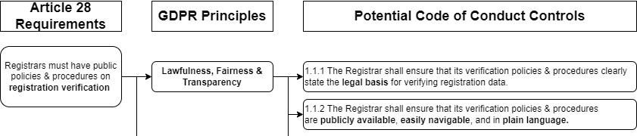
NIS2 Working Group – GDPR Code of Conduct
The WG agreed with the general approach of the voluntary GDPR Code of Conduct:
  The NIS2 WG (on behalf of the PAC) would be “Code Owner” responsible for drafting.
  The draft Code would undergo public consultation with Registrars.
  .ie would act as the “Monitoring Body” for the Code of Conduct.

Slide 24
Tour de Table

Slide 25
Internet Governance
Key Updates & EuroDIG 2024 Debrief
Ireland IGF Announcement

Slide 26
Key Updates – Internet Governance
Updates on WSIS+20 and Global Digital Compact processes
Technical Community Coalition for Multistakeholderism (TCCM)
Debrief from EuroDIG 2024 and Baltic Domain Days 2024
  EuroDIG: Discussions on EU Policy, Digitalising Public Services, AI
  BDD: Discussions on Domain Names, IP Rights, ccTLD Abuse Rates

Slide 27
Ireland Internet Governance Forum
The UN Internet Governance Forum (IGF) is a multi-stakeholder platform for policy discussions related to internet governance.
National and Regional Initiatives (NRI) are events organized by local internet communities in a “bottom-up” manner.
To date, Ireland has never hosted a national IGF event.
Multistakeholder Core Organising Team established.
Aim for launch event in Q4 2024; main event in Q2 2025

Slide 28
AOB

Slide 29
Next Meetings - 2024
  PAC 41: 10 October 2024
  PAC 42: 12 December 2024

Slide 30


