Slide 1


41st Policy Advisory Committee
31st October 2024

Slide 2

Agenda
Introduction & Membership Matters
Matters Arising
  PAC Elections
  Update on Policy Proposals
  New: Transfer Policy issue
Disputes and Abuse
  Dispute Resolution Stats
  NetCraft Service Update
  Internet Watch Foundation – Update
NIS2 Updates
  Key Updates
  Updates from Working Group
  Policy Approaches to Verification
  Likely Changes from NIS2
AOB

Slide 3
Membership Matters
Please keep microphones muted throughout the call
Please "raise a hand" to ask a question or add comments in the chat box
Before speaking, please state your name for the record
Meeting will be recorded to assist with minute drafting
Recording will be deleted once the Minutes are approved by the PAC

Slide 4
Minutes of PAC #40
Meeting minutes are circulated to the membership after each meeting.
Comments & feedback are accepted over a two-week period.
If edits are requested, and consensus exists, these are reflected in the Minutes.
Minutes and slides are published on weare.ie after the comment period has ended.

Slide 5

Registrar Elections
Updates to Organisation List
Update to PDP
Issue Identified: Transfer Policies
Matters Arising

Slide 6
PAC Elections & Membership
Term Length for most .ie Registrar Representatives ends this year.
Election timing in Q1 2025 before PAC 43.
Non-elected members will also be asked to confirm their membership.
Potentially new members from digital regulators.

Slide 7
PAC Proposal Updates: Eligible Organisations
Current List (Apr 2021) | New List (Approved 21 October 24)
*Amend Name* Department of Communications, Climate Action & Environment (DCCAE) *Amend Name* Department of Business, Enterprise & Innovation (DBEI) *Amend Name*Internet Service Providers Association of Ireland (ISPAI) Accredited .ie Registrars Irish Computer Society (ICS) Law Society of Ireland Small Firms Association (SFA) *Amend Name* Association of Registry of Patents and Trademarks (APTMA) HEAnet Enterprise Ireland *Amend Name* Cybersafe Ireland Irish Reporting & Information Security Service (IRISS) | Observer Members Department of Environment, Climate & Communications (DECC) Department of Enterprise, Trade and Employment (DETE) Enterprise Ireland *New* Commission for Communications Regulation (ComReg) *New* Data Protection Commission (DPC) *New* Coimisiún na Meán (CnaM) *New* Competition & Consumer Protection Commission (CCPC) Non-Observer Members .ie Accredited Registrars Association of Patent & Trade Mark Attorneys (APTMA) CyberSafeKids HEAnet Hotline.ie Irish Computer Society (ICS) Irish Reporting & Information Security Service (IRISS) Law Society of Ireland Small Firms Association (SFA)

Slide 8
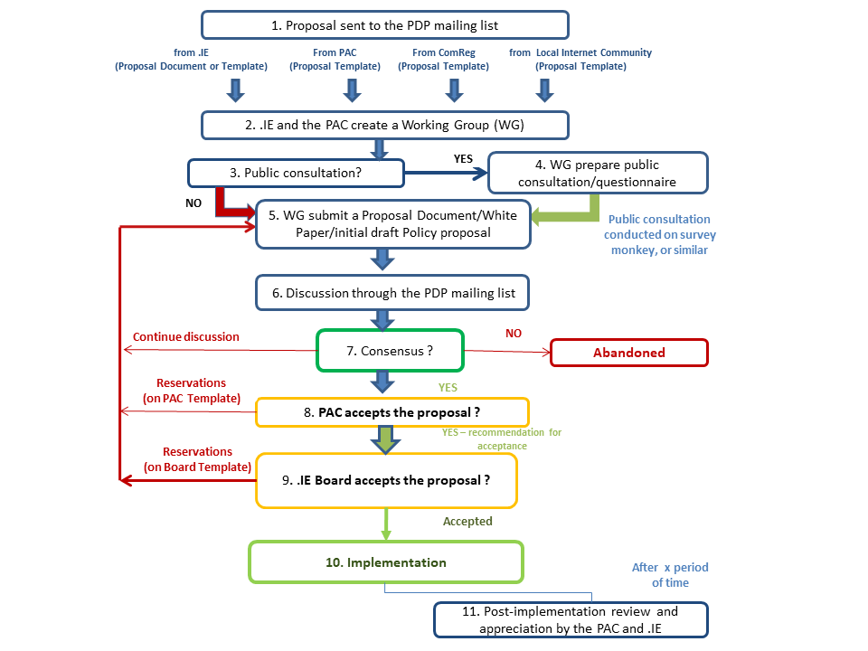
PAC Proposal Updates: Update PDP
Current PDP Model
Issues
Not reflective of practice.
Every proposal requires working group.
No process for minor (de minimis) issues

Slide 9
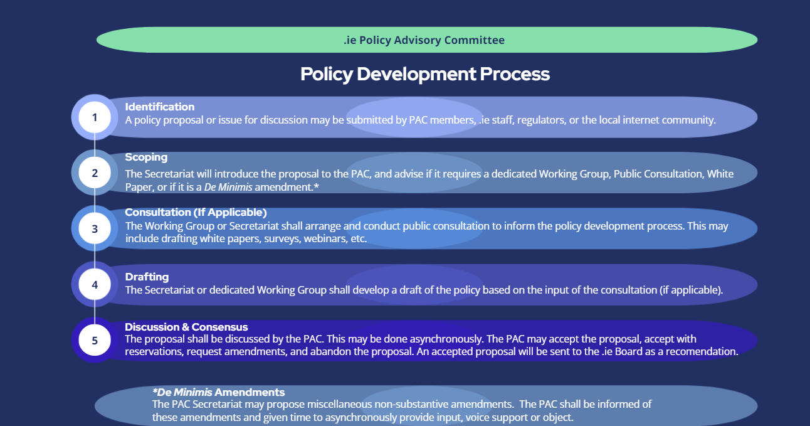
PAC Proposal Updates: Update PDP

Slide 10
PAC Proposal Updates: Update PDP
Identification
Scoping*
Consultation (if applicable)
Drafting
Consensus
Introduction
Asynchronous Review
Amendments (if applicable)
Adoption
*De Minimis Proposals (e.g, typos, updating, names, non-substantive changes)

Slide 11
Issue Identified – Possible Transfer Policy Gap
Background
Large domain holder allowed domain to go into redemption period. A label preventing the domain from transferring Registrars had been applied.
Domain holder then requested a transfer right before domain was deleted.
To facilitate transfer, domain had to be reactivated, re-deleted, which extended domain lifecycle by 30 days.
Questions
Is a policy required to prevent this practice (e.g. limitations on when transfers can be requested)?
Next Steps
Secretariat to scope issue for next meeting to determine if it is operational or a policy question.

Slide 12
Disputes & Abuse
Updates from NetCraft Service
Internet Watch Foundation - Update

Slide 13
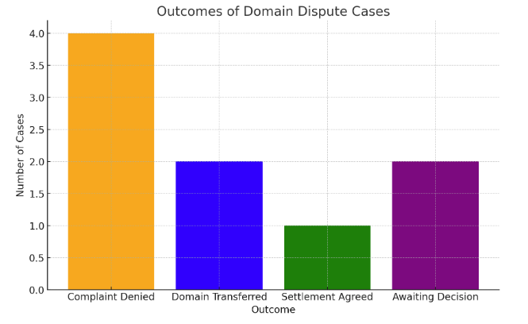
Alternative Dispute Resolution Cases
ADRP Outcomes YTD (2024)
Reasons for Complaints:
Trademark Infringements (3)
Bad Faith & Cybersquatting (5)
Outcomes:
Complaint Denied (4)
Domain Transferred (2)
Settlement (1)
Decision Pending (2)

Slide 14
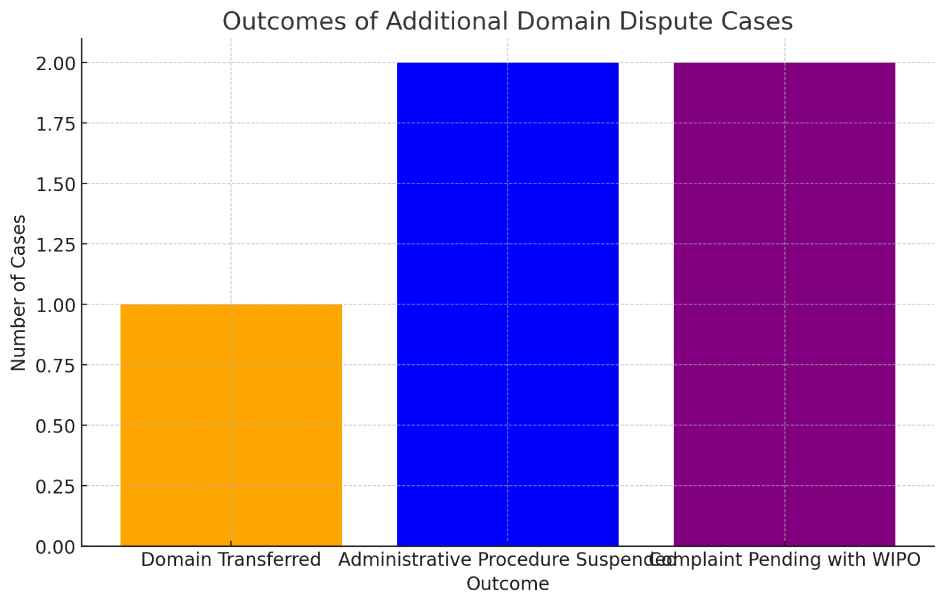
Dispute Resolution Cases
WIPO Outcomes YTD (2024)
Reasons for Complaints:
Trademark Infringements (4)
Bad Faith (1)
Outcomes:
Domain Transferred (1)
Settlement (2)
Complaint Pending (2)

Slide 15
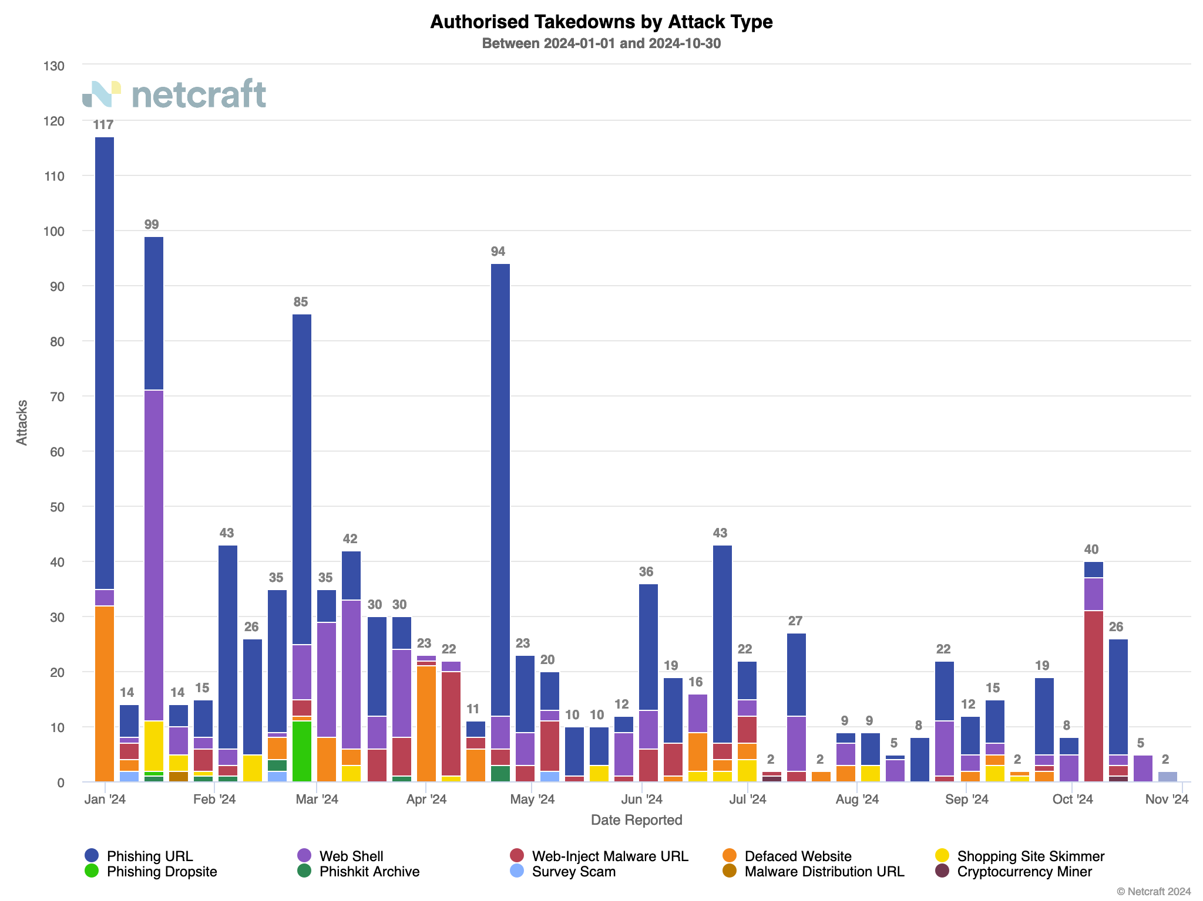
NetCraft Updates
Number of Attacks (YTD)

Slide 16
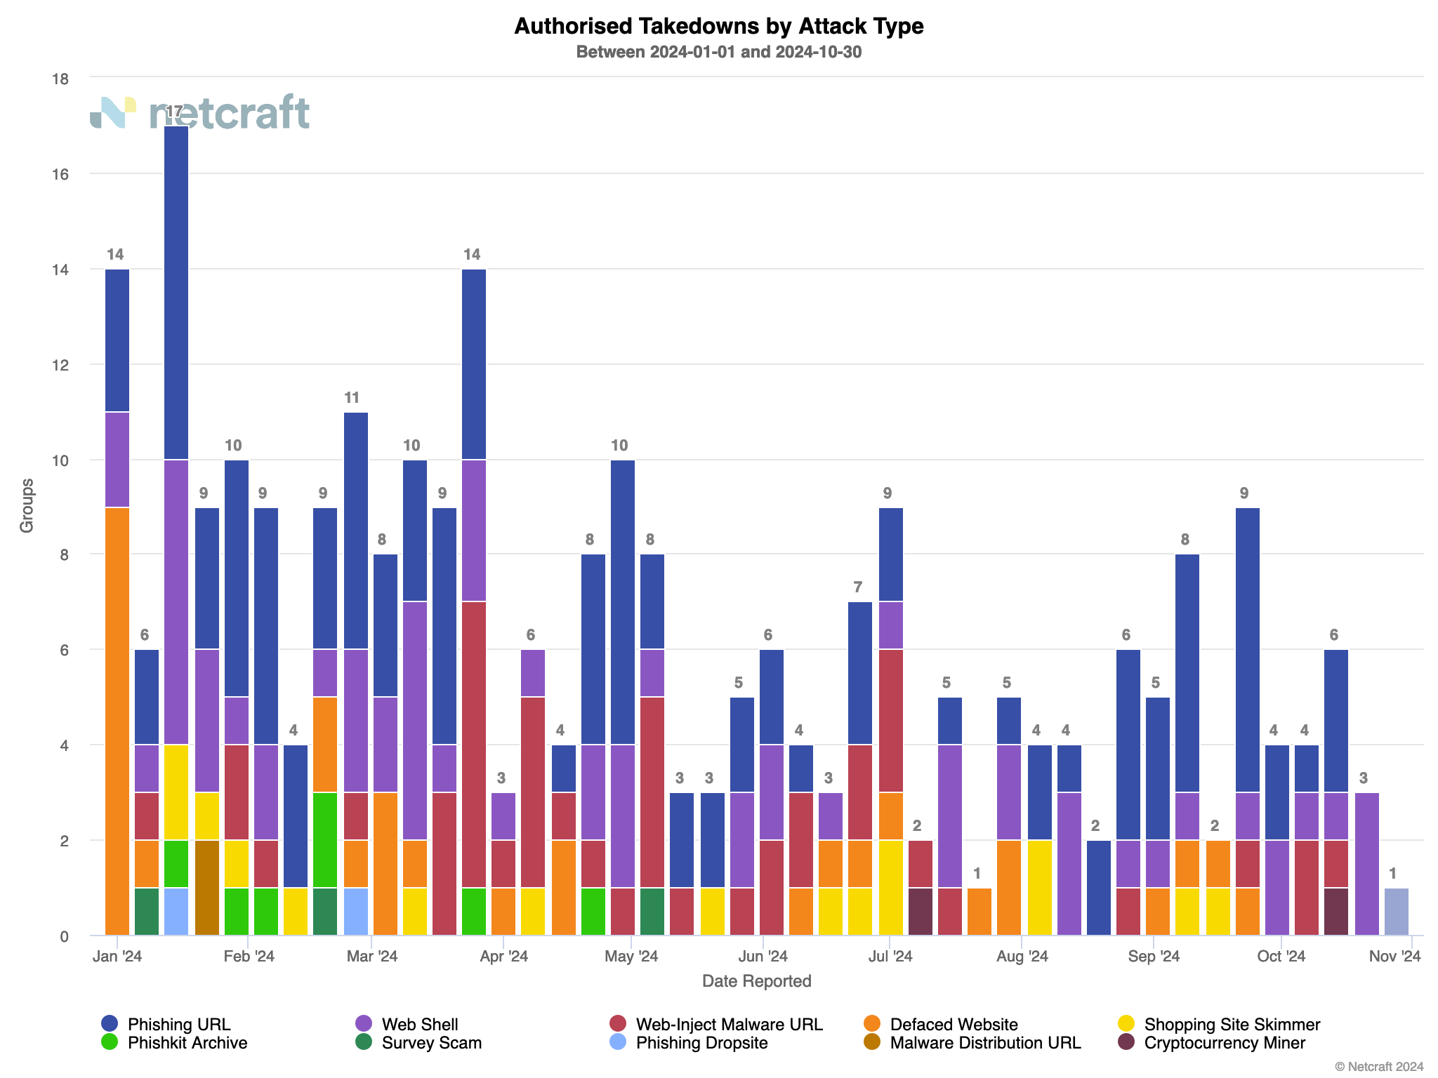
NetCraft Updates
Attacks by Group (YTD)

Slide 17
Update – Internet Watch Foundation
At PAC 39, the IWF presented on their Domain Alert and TLD Hopping List Services.
  Domain Alert provides real-time alerts of confirmed CSAM on a TLD’s domain.
  TLD Hopping List provides list of domain strings known to distribute CSAM.
Domain Alert service has been adopted. Hotline.ie was consulted on internal process.
TLD Hopping List not adopted currently – requires technical changes. May not be proportionate to risk.

Slide 18

Tracker
Key Updates
Updates from Working Group
Registrar Survey
Potential Upcoming Changes
Tour de Table
NIS2

Slide 19
Tracker
Actions taken since last PAC Meeting (11th July 2024)
Alignment Ensure that .IE Policies and Processes are aligned with NIS2 requirements | Advocacy Frequently present the concerns and views of stakeholders to policymakers | Awareness Actively inform Registrars of impending changes from NIS2
NIS2 WG Meeting held (29 Oct 2024) Impact Analysis on NIS2 Leading taskforce on RGY code of conduct Work underway on a RAR code of conduct. | Call with NCSC RE: Implementing Acts Met with ComReg (August) Engagement on NIS CG recommendations Submitted evidence via IBEC for PLS | NIST RAR Webinar held in July RAR survey on NIS2 launched
4
Actions taken
4
Actions taken
2
Actions taken

Slide 20
Key Legislative Updates
Transposition deadline missed – NCSC still launching online Portal.
National Cyber Security Bill undergoing Pre-Legislative Scrutiny.
Implementing Acts (regarding Article 21) adopted.
NIS CG Recommendations Released.
  Non-Binding; Must be Transposed if Adopted.

Slide 21
NIS Cooperation Group Recommendations
Registration Verification
Validating Syntax and Verifying Email and Phone of RANTs/AdminCs (if different) at Registration and Renewal.
Using risk-based approach to verifying IDs (for both natural and legal entities).
Periodic checks of data base for “medium to high risk” domain names (updating contacts, reports from law enforcement, etc.).
Legitimate Access Seekers
Ensure all national authorities are designated as legitimate access seekers
May also designate other public authorities and private entities as LAS
Information should be provided within 72 hours
Reasons for refusal should also be provided within 72 hour (may be 24 hours for urgent requests)

Slide 22
NIS Cooperation Group Recommendations
Higher threshold than current industry practice
Questions of proportionality and data minimisation
Questions of Feasibility:
Processes for verifying contact info?
Lifecycle Points where Verification Feasible?
Choices | RANT | AdminC
Yes – both emails and phone | 2 (12.5%) | 2 (12.5%)
Yes – for emails or phone | 2 (12.5%) | 0
Yes – for phones only | 0 | 0
Yes – for emails only | 8 (50%) | 5 (31.25%)
No | 4 (25% | 9 (56.25%)
Choices | Via Email | Via Phone
New Registration | 15 (93.75%) | 9 (56.25%)
Renewal | 1 (6.25%) | 1 (6.25%)
Request to transfer RANTs | 6 (37.5%) | 5 (31.25%)
Request to transfer RARs | 6 (37.5%) | 4 (25%)
Request to update contacts | 10 (62.5%) | 7 (43.75%)
Report of malicious/fake registration | 9 (56.25%) | 6 (37.5%)
None | 0 | 3 (18.75%)

Slide 23
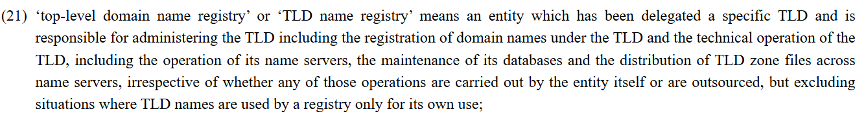
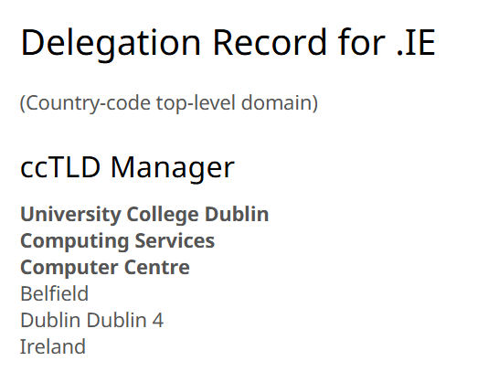
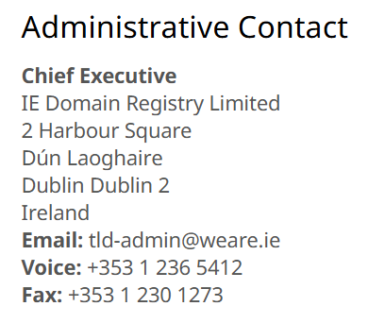
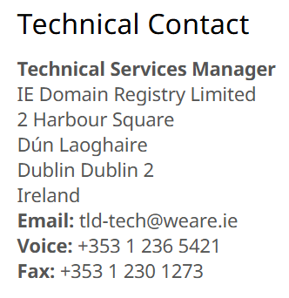
NIS2 Working Group
Scoping Issue: Unresolved questions about definition of “TLD Name Registry” in NIS2

Slide 24
NIS2 Working Group
Policy Approaches to Registrant Verification was discussed:
III You must achieve this outcome. How is up to you. | IV You must implement this process in this particular way.
I We would like you to achieve this outcome. | II We would like you to implement this process.
Approach III found to be most proportionate and offers most flexibility to Registrars.
Example: Registrars must verify contact info of RANT & AdminC (if applicable).
Directive
Suggestive
Outcomes Based
Procedural Based

Slide 25
Probable Changes
Legislation still pending – requirements still unknown.
Prelim Impact Analysis conducted.
Likely areas of change:
  Updates to Accredited Registrar Agreements
    New Accreditation Framework
  Updates to Registration & Naming Policy
  Updates to Privacy Policy
  Updates to Regulatory Authority Protocol

Slide 26
Tour de Table

Slide 27
Registrar Day Event post PAC-42 (28 November 2024) in Dublin.
Internet Governance Forum Ireland planned for 22 May 2025 in Dublin.
AOB

Slide 28
Next Meetings - 2024
  PAC 42: 28 November 2024

Slide 29


