Slide 1


42nd Policy Advisory Committee
28th November 2024

Slide 2

Agenda
Introduction & Membership Matters
Matters Arising
  End of Year Business
  Scoping: Transfer Policy issue
  2025 Priorities
Disputes and Abuse
  NetCraft Service Update
NIS2
  Year in Review
AOB
  2025 PAC Dates

Slide 3
Membership Matters
Please keep microphones muted throughout the call
Please "raise a hand" to ask a question or add comments in the chat box
Before speaking, please state your name for the record
Meeting will be recorded to assist with minute drafting
Recording will be deleted once the Minutes are approved by the PAC

Slide 4
Minutes of PAC #41
Due to the closeness of PAC 41 & 42, minutes both PAC meetings will be distributed following PAC 42.
Comments & feedback are accepted over a two-week period.
If edits are requested, and consensus exists, these are reflected in the Minutes.
Minutes and slides are published on weare.ie after the comment period has ended.

Slide 5

End of Year PAC Business
Scoping: Transfer Policy
2025 Priorities
Matters Arising

Slide 6
End of Year PAC Business
Non-Voted Members
Will be asked if they seek to continue term on the Policy Advisory Committee.
Accredited Registrars
Elections to be held January 2025 for Registrars (with the exception of EuroDNS).
Registrars may run for election again.
Comms will be prepared for the RAR Channel.
End of Year Appreciation
Small tokens of appreciation for the PAC Members.
  Alternative to donate to a charity of your choice.

Slide 7
Re-Cap: Updated PDP
Identification
Scoping*
Consultation (if applicable)
Drafting
Consensus
Introduction
Asynchronous Review
Amendments (if applicable)
Adoption
*De Minimis Proposals (e.g, typos, updating, names, non-substantive changes)

Slide 8
Scoping – New Transfer Policy
Background
Large domain holder used specific function (Registrar Transfer) to extend the lifecycle of a domain in redemption period by 30 days.
Question from PAC 41: Is a new Transfer Policy needed to prevent this practice?
Recommendation
It is recommended the PAC does not pursue a policy change.
Rationale
Issue is an edge case – not indicative of a wide-spread issue.
Operational in nature. Policy is not appropriate tool to address it.

Slide 9
2025 PAC Potential Priorities
Website Overhaul Policy Review WG | Policy Change Requests NIS2 & CER Directive Regulatory Scanning
De Minimis Issues (typos, etc.) | N/A
Higher Importance
Lower Importance
Less Complex
More Complex

Slide 10
What To Watch For (2025)
NIS2 Transposition
High Risk
Med Risk
Low Risk
 | Jan | Feb | Mar | Apr | May | June | July | Aug | Sep | Oct | Nov | Dec
CER Directive
AGRI GI Study
National Risk Assessment
POSSIBLE “ROGUE WAVES” Being captured by DORA as “critical function” MiCA Statutory Instrument Age Verification/Digital Passports/eID New Levies under DSA & NIS2 | Preservation & Production Orders Legislation Insolvency Harmonisation Proposal CIGI GI Study

Slide 11
Disputes & Abuse
Updates from NetCraft Service

Slide 12
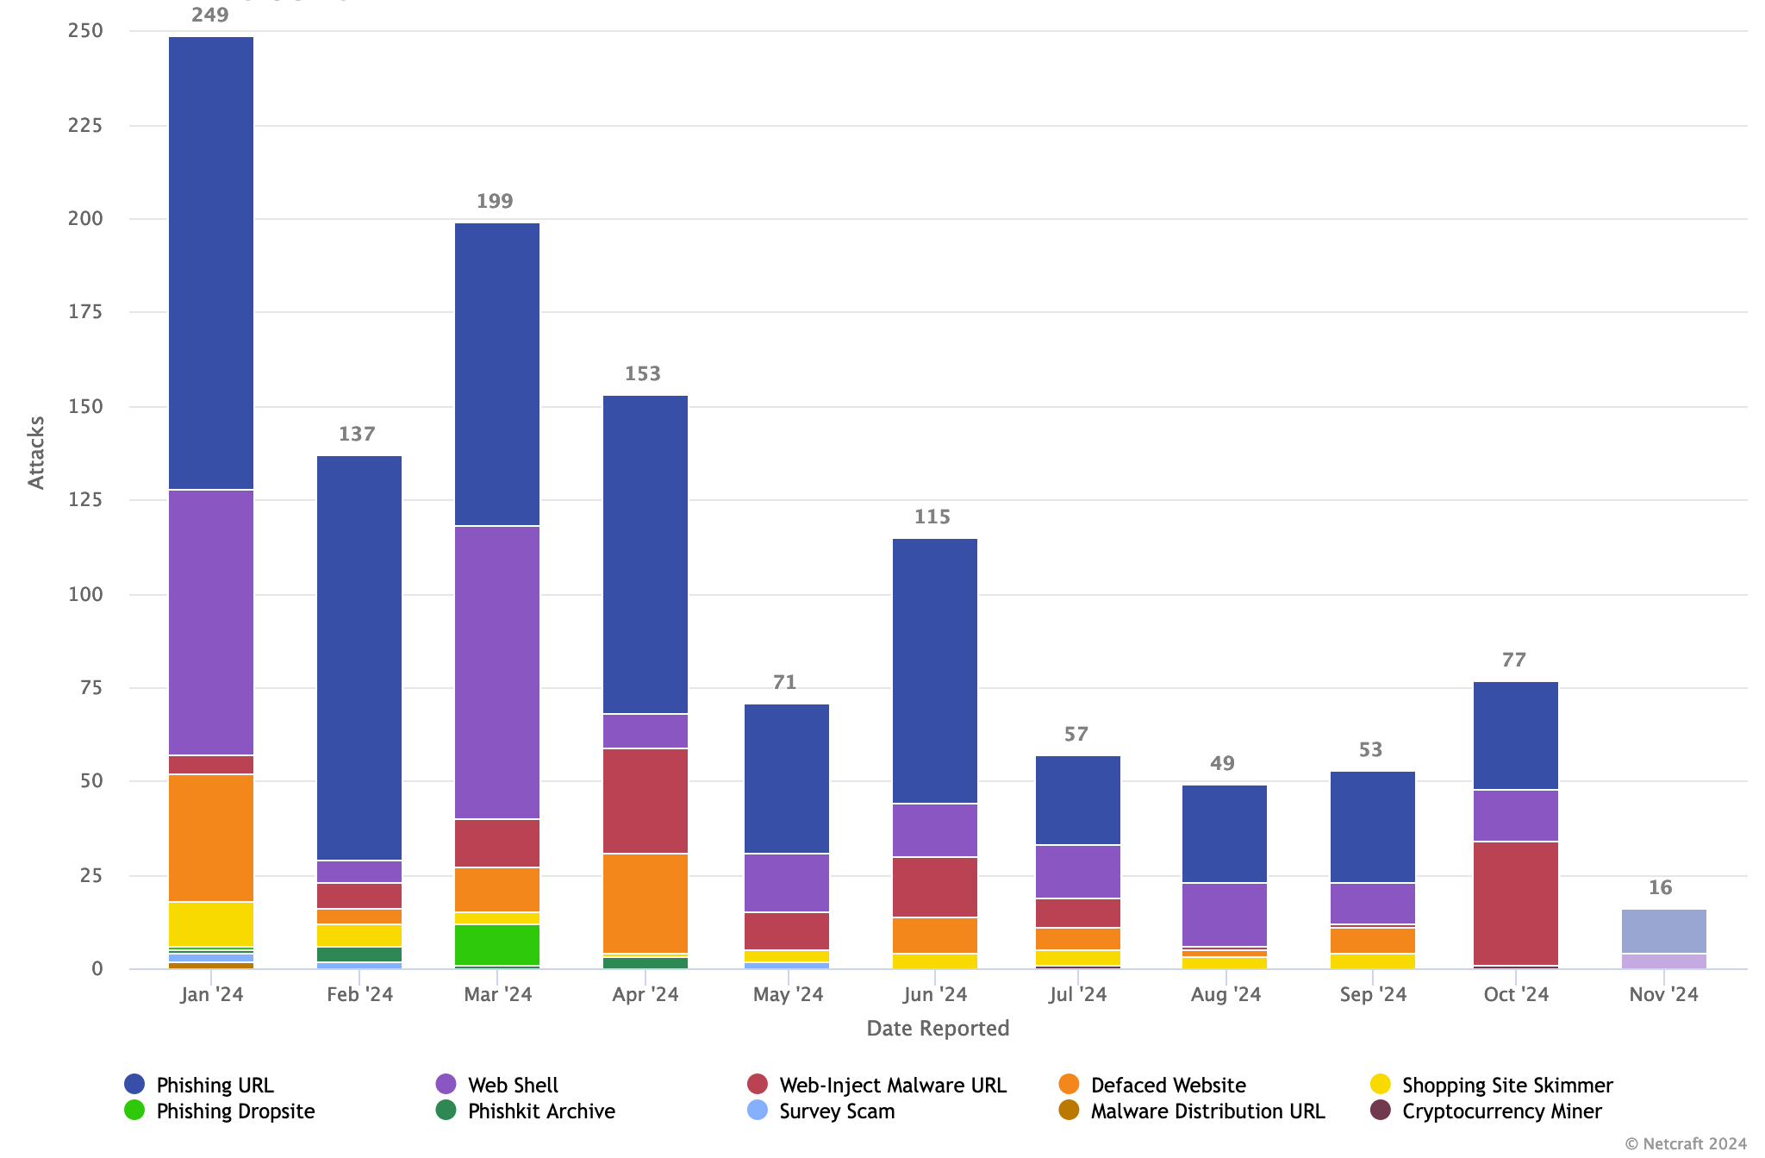
NetCraft Updates
Number of Attacks (YTD)

Slide 13
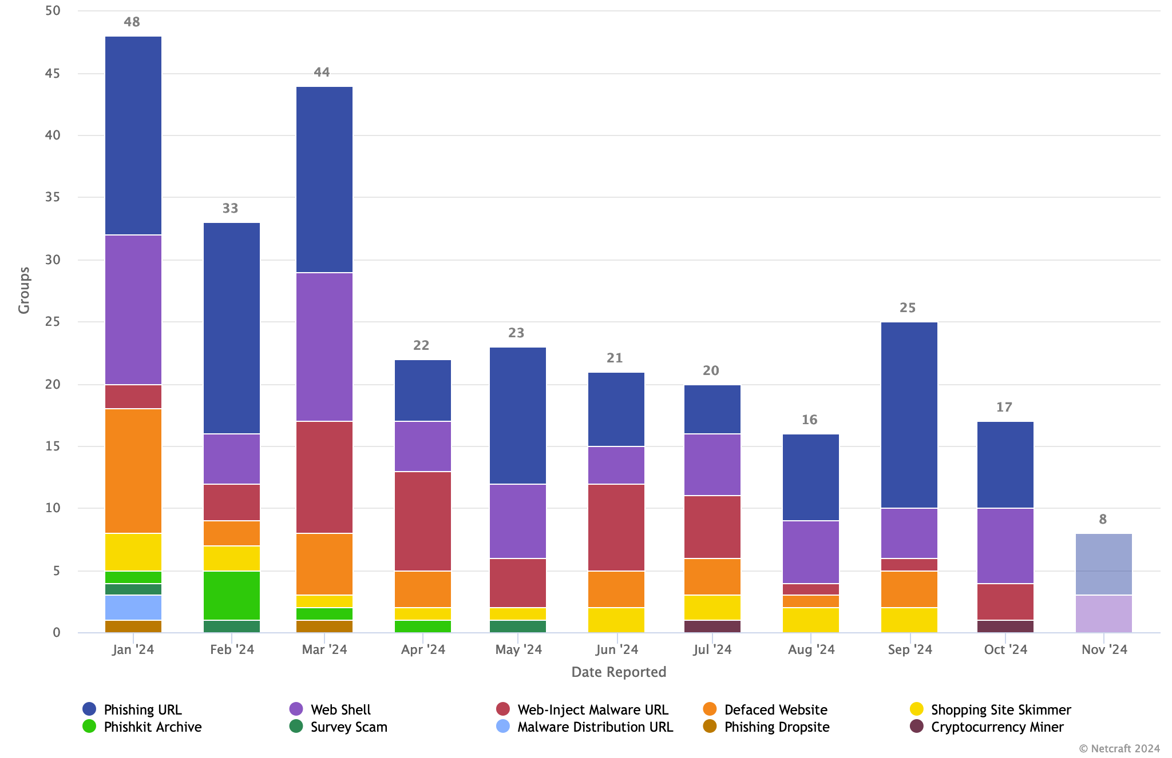
NetCraft Updates
Attacks by Group (YTD)

Slide 14

Year-in-Review
Tour de Table
NIS2

Slide 15
Tracker – Year In Review
Alignment Ensure that .IE Policies and Processes are aligned with NIS2 requirements | Advocacy Frequently present the concerns and views of stakeholders to policymakers | Awareness Actively inform Registrars of impending changes from NIS2
4 NIS2 WG Meetings Held. Identified main risk areas in Heads of Bill. Launched Accreditation Framework. Formed CENTR taskforce on navigating GDPR & Art.28. Developed general policy approach for NIS2 Compliance. | Submitted views in Pre-Legislative Scrutiny (via IBEC). Engaged with DETE Minister. Engaged with NCSC & DECC on: Heads of Bill Implementing Acts NIS CG Recommendations Advised NCSC for WHOIS Workstream discussions. Participated in study with ENISA. Met with ComReg on future regulatory role. Engaged with DPC on Art 28 and NIS CG. | 4 Blog Posts related to NIS2 3 Eolas Articles on NIS2 1 Podcast 2 Registrar Webinars 1 Registrar Survey on NIS2

Slide 16
Tour de Table

Slide 17
AOB
PAC Secretariat to send out list of potential 2025 dates for PAC review.

Slide 18


