Slide 1


43rd Policy Advisory Committee
13th February 2025

Slide 2

Agenda
Introduction & Membership Matters
Matters Arising
  PAC Election Results & New Members
  Ireland and EU Policy Updates
  Policy Review Working Group
Disputes and Abuse
  WIPO and ADRP Cases
  NetCraft Service Update
NIS2
AOB

Slide 3
Membership Matters
Please keep microphones muted throughout the call
Please "raise a hand" to ask a question or add comments in the chat box
Before speaking, please state your name for the record
Meeting will be recorded to assist with minute drafting
Recording will be deleted once the Minutes are approved by the PAC

Slide 4
Minutes of PAC #42
Meeting minutes are circulated to the membership after each meeting.
Comments & feedback are accepted over a two-week period.
If edits are requested, and consensus exists, these are reflected in the Minutes.
Minutes and slides are published on weare.ie after the comment period has ended.

Slide 5

Matters Arising
  PAC Membership
  Policy Updates
  Policy Review Working Group

Slide 6
PAC Membership
Congratulations
Leanne Kenny (MarkMonitor)
Michele Neylon (Blacknight)
Will Harrison (Hosting Ireland)
Leaving Members
Prudence Malinki (MarkMonitor)
Jill Colquhoun (DETE)
Alex Cooney (CyberSafeKids).
Cormac Callanan (ICS)

Slide 7
Policy Update
Ireland
Programme for Government
  Online Safety (Age verification, EU CSAM Directive, support for Hotline, etc.).
  New “National Cybersecurity Strategy”, “National Digital Strategy” (digital passport)
  Tackling Fraud - “Shared Fraud Database”
  NCSC and Internet Policy to be moved to Department of Justice
.ie ccTLD Public Consultation
EU
CIGI and Domain Name Alert System
Modernisation of IPRED

Slide 8
Policy Review Working Group
Purpose: To ensure that the .ie policy suite is regularly reviewed and updated
Objectives:
  Proactively flag policy gaps, and other issues in the .ie policy suite.
  Make recommendations on if issue requires PDP or De-Minimis Amendment.
Commitment:
  Semi-Quarterly (twice per year) Call
  Some asynchronous review work
Scope:
  Limited to external .ie policy suite
  Policies to be reviewed on staggered approach
  Will avoid duplication with NIS2 Working Group

Slide 9
Re-Cap: Updated PDP
Identification
Scoping*
Consultation (if applicable)
Drafting
Consensus
Introduction
Asynchronous Review
Amendments (if applicable)
Adoption
*De Minimis Proposals (e.g, typos, updating, names, non-substantive changes)

Slide 10
Disputes & Abuse
Dispute Updates
Updates from NetCraft Service

Slide 11
ADRP and WIPO Disputes (2024)
ADR
RESULT | TOTAL IN 2024
Transferred (Abusive or Bad Faith) | 4
Transferred (Settlement) | 1
Cancelled | 1
Dismissed | 3
Total | 9
WIPO
RESULT | TOTAL IN 2024
Resolved by Parties | 3
Transfer | 2
Total | 5

Slide 12
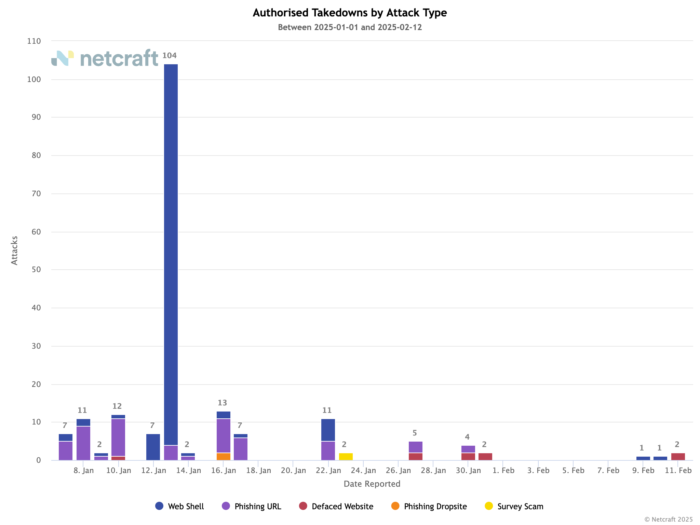
NetCraft Updates
Number of Attacks by Type ( 2025 YTD)

Slide 13
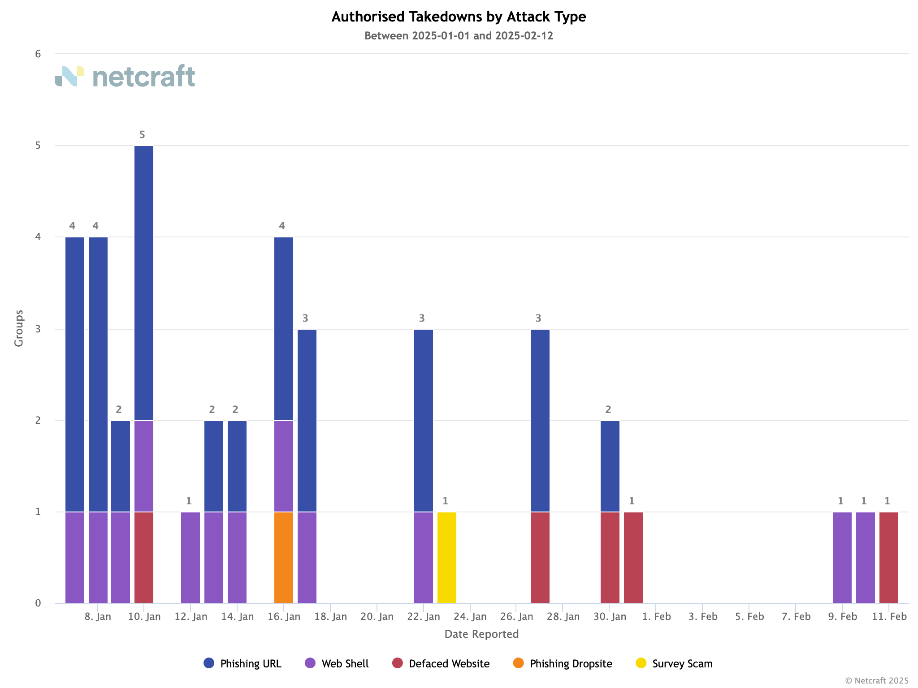
NetCraft Updates
Number of Attacks by Group ( 2025 YTD)

Slide 14

Recap
Updates
2025 Goals
Recap
Tour de Table
NIS2

Slide 15
Key Updates – NIS2
Oct 17 deadline missed, and Jan 28 deadline missed
National Cyber Security Bill stalled at PLS during talks with committee
Requires committee to be established under new government to continue
May have delays from new “National Cyber Security Strategy” and move from DECC to Department of Justice.

Slide 16
2025 Goals (NIS2)
 | Alignment | Advocacy | Awareness
Essential | Policies aligned with NIS2 | Dissuade transposition of NIS CG Recommendations | .ie Registrars are aware of requirements with adequate time to prepare
Important | Verification is harmonised with other ccTLDs | National Competent Authority (ComReg) sits on PAC | .ie Registrars are aware of accreditation framework
Desirable | Publish Guidance for .ie Registrars on navigating GDPR & NIS2 | Provide input to government on NIS2 compliance regime | .ie remains aware of other jurisdictional processes

Slide 17
Tour de Table

Slide 18
AOB
NEXT PAC MEETING: 05 JUNE 2025.

Slide 19


