Slide 1


45ᵗʰ Policy Advisory Committee
16ᵗʰ October 2025
Proprietary

Slide 2

Agenda
01
Introductions & Membership Matters
Matters Arising
Disputes & Abuse
NIS2 Updates
AOB
02
03
04
05
Notes:
12

Slide 3
Membership Matters
  Please keep microphones muted throughout the call
  Please "raise a hand" to ask a question or add comments in the chat box
  Before speaking, please state your name for the record
  Meeting will be recorded to assist with minute drafting
  Recording will be deleted once the Minutes are approved by the PAC
Notes:
3

Slide 4
Minutes of PAC 44
  Meeting minutes are circulated to the membership after each meeting.
  Comments & feedback are accepted over a two-week period.
  If edits are requested, and consensus exists, these are reflected in the Minutes.
  Minutes and slides are published on weare.ie after the comment period has ended.
Notes:
4

Slide 5
Legislative & Regulatory Updates
Autumn 2025 Legislative Programme includes NIS2 and other low-risk legislation
STAGE
TITLE
RISK
COMMITTEE STAGE (SEANAD ÉIREANN)
Defamation (Amendment) Bill 2024
PRIORITY PUBLICATION
National Cyber Security Bill (NIS2)
Criminal Justice (International Cooperation) (Amendment) Bill
PRIORITY PUBLICATION
Criminal Justice (Protection, Preservation of and Access to Data on Information Systems) Bill
PRIORITY DRAFTING
Notes:
6

Slide 6





Policy Updates
Policy priorities for the rest of 2025 include modernising Connection-to-Ireland, and convening the NIS2 Working Group
Proposal | Originator | Status | Timeline | Next Steps
De Minimis Amendments to Policy Suite | .ie |  | Q4 2025 | Updated policies to be publicly available
Modernising the Connection-to-Ireland | .ie |  | Q4 2025 | Discussion Paper to be drafted for PAC 46 (Nov 2025)
NIS2 Policy Amendments | .ie |  | Q1 2026 | NIS2 Working Group to meet (Nov 2025)
Amendments to Charity Policy | .ie |  | 2026 | Issue proposed to be revisited post-NIS2
Completed
Scoping
Blocked
Backlog
Notes:
6

Slide 7
Other Matters Arising
01
.ie to join the Irish Internet Hotline as member
Awaiting final approval for .ie Terms of Endorsement
ICANN 84 in Dublin from 25 – 30 October 2025
02
03
Notes:
6

Slide 8
Dispute Resolution
Notes:
6

Slide 9
Requests for Registrant Data Disclosure
Notes:
6

Slide 10
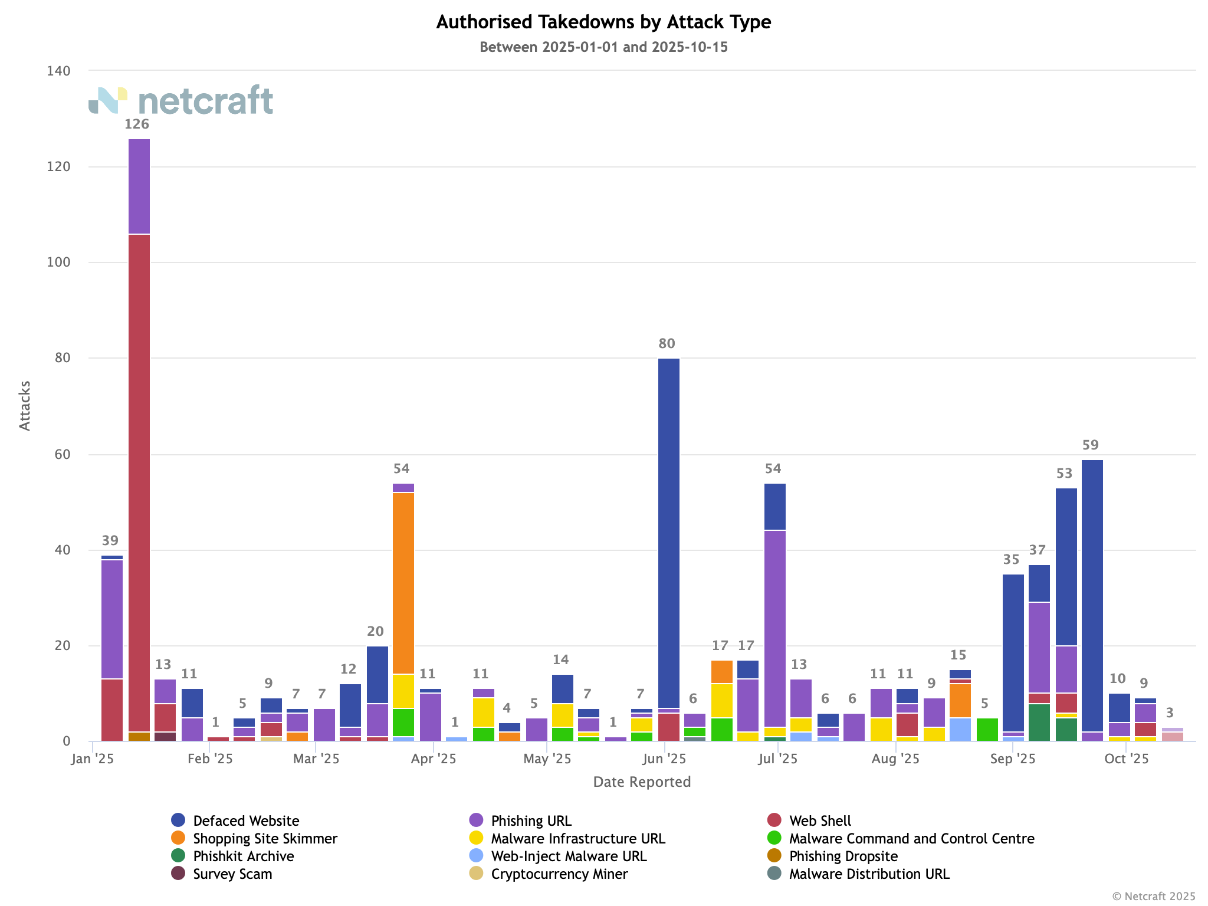
NetCraft Update – Attacks by Type
Notes:
6

Slide 11
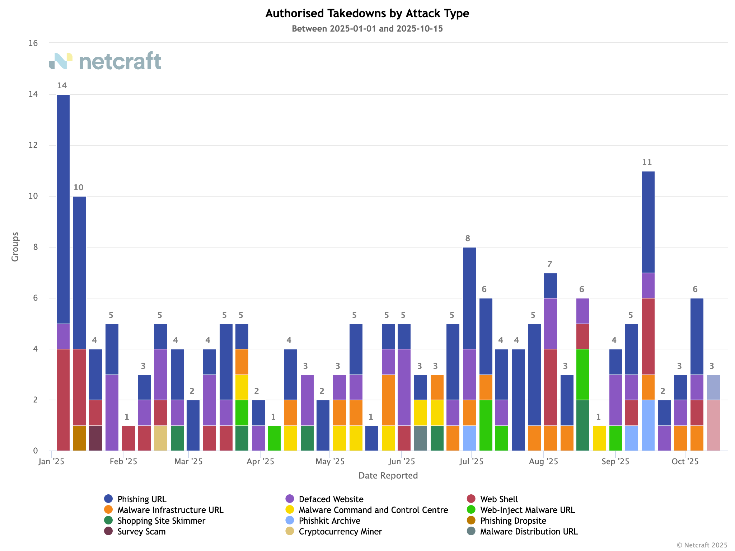
NetCraft Update – Attacks by Group
Notes:
6

Slide 12


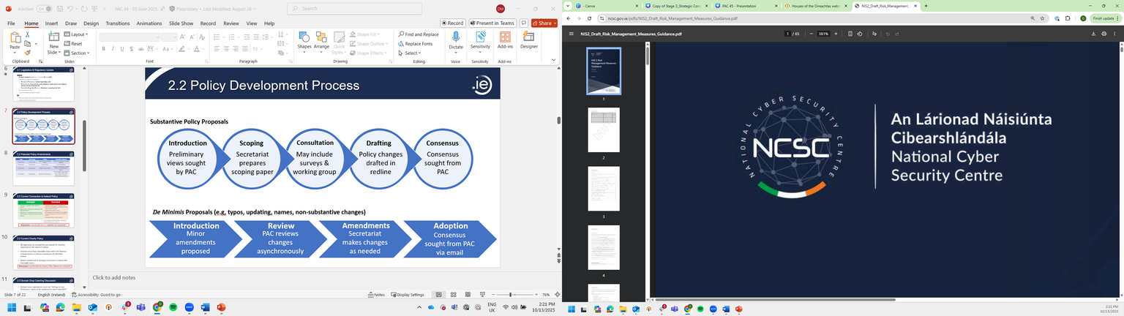

NIS2 Updates
Movement has happened over NIS2 over the last quarter that suggests transposition is forthcoming. The NIS2 Working Group is set to meet in November.
Autumn 2025 Legislative Program: Priority for Publication
Budget 2026: Funding for NCSC to begin NIS2 implementation
Risk Management Measures & CyFUN Certification Released
NIS2 Working Group Meeting (Nov 2025)
Notes:
6

Slide 13
AOB
01
Next Meeting: 27 November 2025
Holiday Lunch & PAC Photos
02
Notes:
6

Slide 14

Proprietary

