Slide 1


46ᵗʰ Policy Advisory Committee
27ᵗʰ November 2025
Proprietary

Slide 2

Agenda
  Introduction & Membership Matters
  Matters Arising
    Policy Change Request: Repealing the Charity Policy (Initiation Stage)
  Disputes and Abuse Updates
  NIS2 Updates
  AOB

Slide 3
Membership Matters
  Please keep microphones muted throughout the call
  Please "raise a hand" to ask a question or add comments in the chat box
  Before speaking, please state your name for the record
  Meeting will be recorded to assist with minute drafting
  Recording will be deleted once the Minutes are approved by the PAC
Notes:
3

Slide 4
Minutes of PAC 45
  Meeting minutes are circulated to the membership after each meeting.
  Comments & feedback are accepted over a two-week period.
  If edits are requested, and consensus exists, these are reflected in the Minutes.
  Minutes and slides are published on weare.ie after the comment period has ended.

Slide 5
Matters Arising - Legislative & Regulatory Updates
01
Positive Updates on AGRI Alert System (CIGI Alert System TBD)
Department of Justice reached out regarding e-Evidence Package
Awaiting final approval for .ie Terms of Endorsement
02
03

Slide 6





Matters Arising - Policy Updates
Proposal | Originator | Status | Timeline | Notes & Next Steps
Expanding eligibility for the Connection-to-Ireland Policy | .ie |  | Q4 2025 | PAC has advised against expanding the eligibility for CTI Policy.
Repealing the .ie Charity Policy | Blacknight |  | Q1 2026 | To be initiated at PAC 46.
NIS2 Policy Amendments | .ie |  | Q1 2026 | Awaiting PLS Report from Oireachtas Committee
Resolved
Initiation
In Progress

Slide 7
Matters Arising: Policy Change Request
Policy Change Request received to Repeal the .ie Charity Policy.
Policy Development Process (PDP)
Introduction
Scoping
Consultation
(If applicable)
Drafting
Consensus
Preliminary views sought by PAC
Secretariat advises if consultation required
Policy changes drafted in redline
Consensus sought from PAC
May include surveys or working group
De Minimis Proposals (e.g, typos, updating, names, non-substantive changes)
Introduction
Review
Amendments
Adoption
Minor amendments proposed
PAC reviews changes asynchronously
Secretariat makes changes as needed
Consensus sought from PAC via email

Slide 8
Matters Arising: Policy Change Request
Policy Change Request received to Repeal the .ie Charity Policy.
Proposal: Repeal the .ie Charity Policy
Background: The Charity Policy allows for registration/renewal fees to be waived for charities in Ireland
Rationale:
        The policy disadvantages Registrars as they provide the same administrative work for no fees.
        The policy often misinterpreted by charities thinking it applies to other services (hosting, etc.)
        Charities also availing of other reductions & discounts, further affecting RAR operational costs
Benefits: Reduced administrative burden and costs for domain name registrars
Risks: Existing charity domain names may lapse from payment issues if the change is too abrupt
DISCUSSION: What are the PAC’s preliminary views on proposal?

Slide 9
Dispute Resolution
Since PAC 45 (16 Oct 2025): 0 new WIPO cases (7 YTD); 2 new ADRP cases (7 YTD)

Slide 10
RAP & Data Disclosure Requests
Since PAC 45 (16 Oct 2025): 1 new request made (9 YTD); Request was rejected.

Slide 11
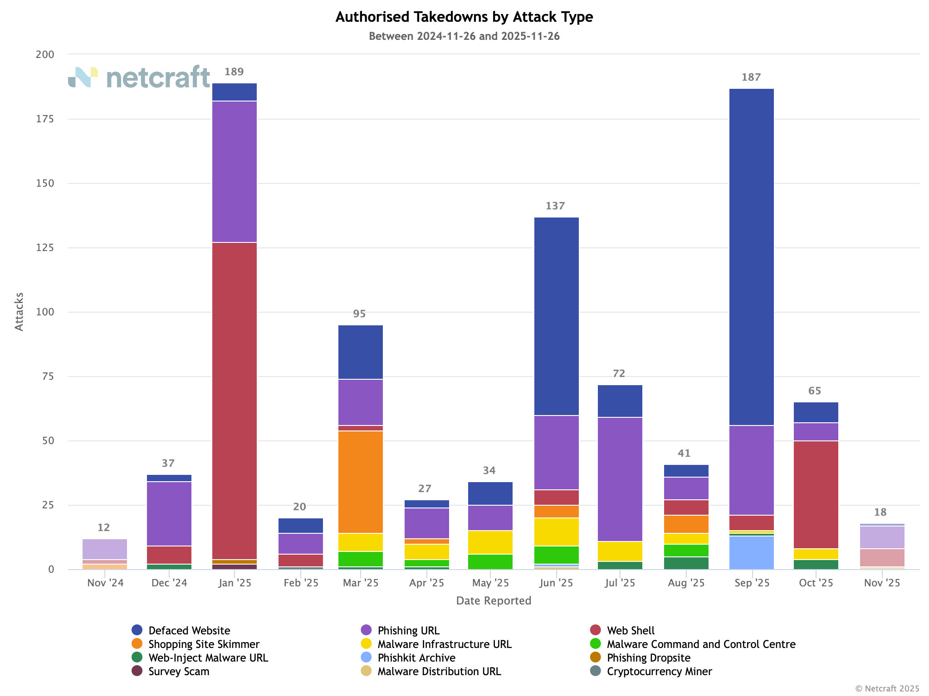
NetCraft Update – Attacks by Type (YTD)

Slide 12
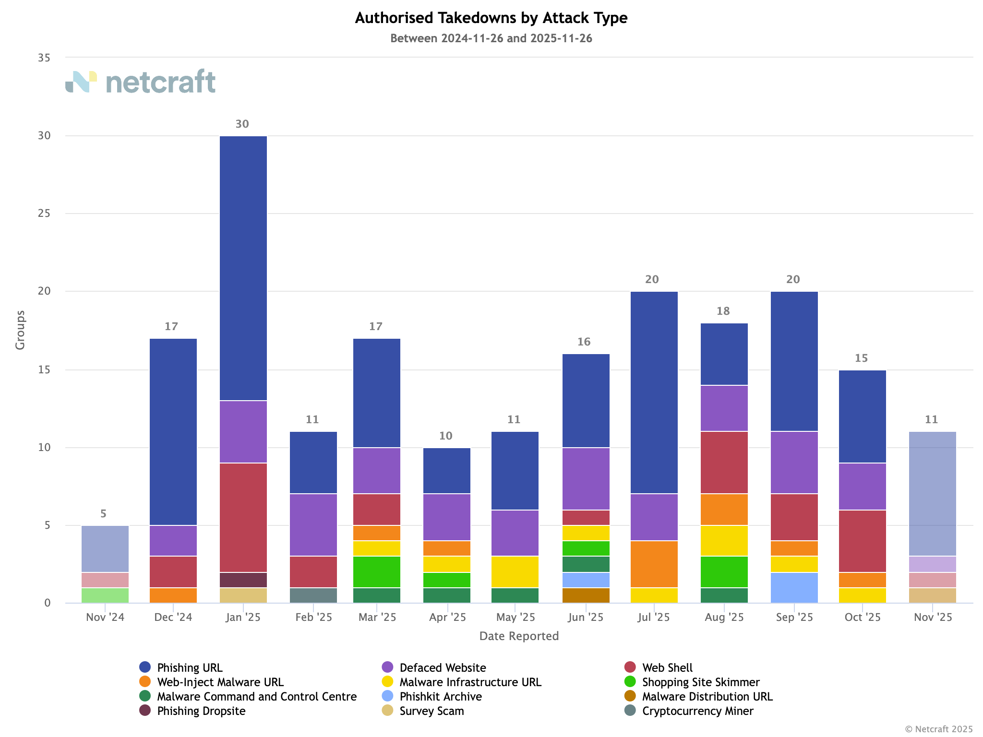
NetCraft Update – Attacks by Group (YTD)

Slide 13
NIS2 Updates – National Cyber Security Bill
1
2
3
General Scheme Published
Pre-Legislative Scrutiny
PLS Report Published
8
7
6
5
4
Third Reading in Dail Éireann
Dail Reporting Stage
Dail Committee Stage
Second Reading in Dail Éireann
First Reading in Dail Éireann
9
10
11
12
13
First Reading in Seanad Éireann
Second Reading in Seanad Éireann
Seanad Committee Stage
Seanad Reporting Stage
Final Reading in Seanad Éireann

Slide 14



NIS2 Updates
Progress on NIS2 remains slow in Oireachtas. However, some new advocacy activity since last PAC meeting.
NIS2 Working Group Meeting (Nov 2025)
    State of Play reviewed.
    Best practices of RANT Verification discussed.
Oireachtas Committee met 25 November to discuss NIS2.
    DNS Blocking & Domain Name Suspensions discussed.
    Committee concerned about NCSC overreach and data protection.
The Registry has been advocating to NCSC, DOJ, and Oireachtas
    Submission to Oireachtas for PLS Report on Article 28
    Conversations with NCSC and DoJ on Article 28

Slide 15
AOB
01
2026 PAC Dates to be determined
End of Year Charity Gifts
02

Slide 16

Proprietary

